Slide 1


Beauty is Good: A Meta-Analysis
Examining perceived and measured associations between attractiveness and key traits
by Junsong LU

Slide 2
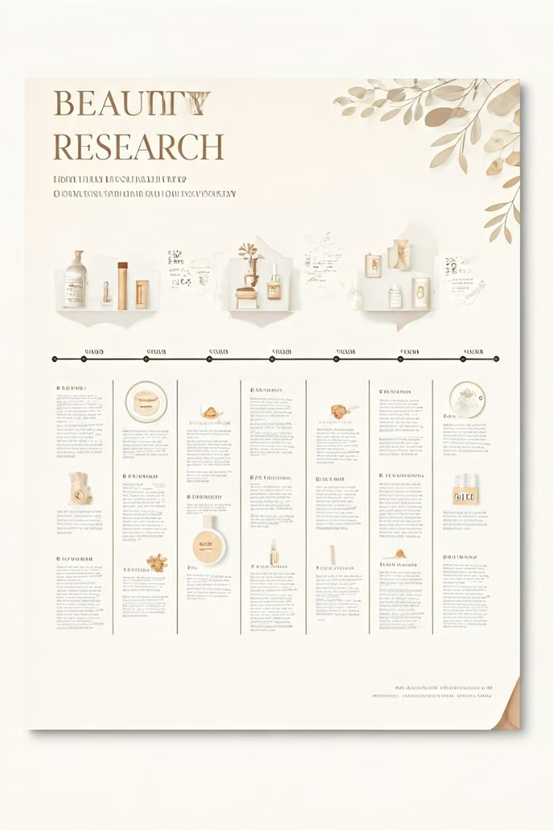
The Beauty-is-Good Effect
1
1972
Dion study introduces "what is beautiful is good"
2
1990s
Meta-analyses confirm effect is strong and widespread
3
Recent
Considered as stereotype or bias by researchers

Slide 3
Explanatory Theories
Economics
Social Psychology
Evolutionary Psychology
Taste-based discrimination in labor market
Status generalization and implicit personality theories
Byproduct of mating preferences

Slide 4
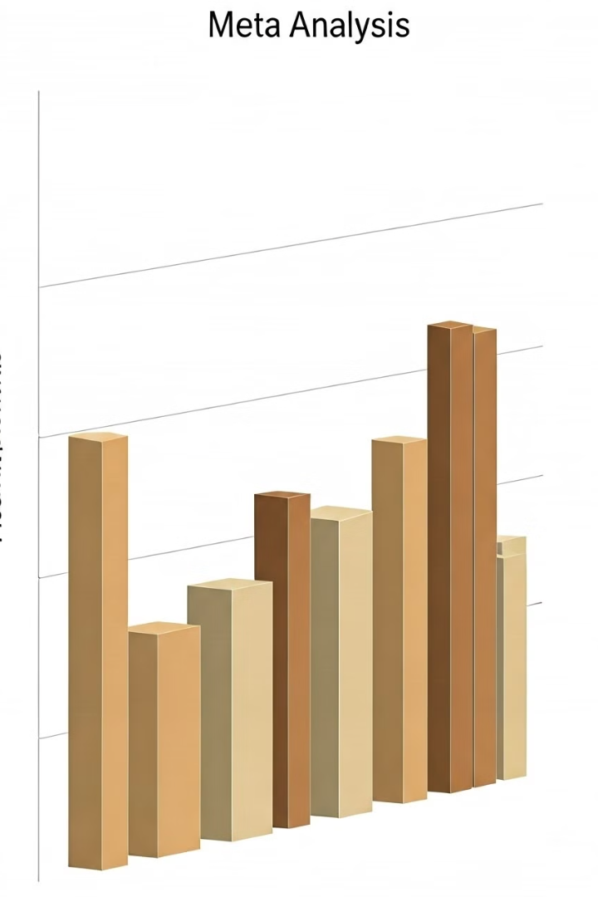
Meta-Analyses Findings
1
Eagjy et al. (1991)
Effect stronger in social competence domains
2
Feingold (1992)
Little covariance between attractiveness and measured traits
3
Jackson et al. (1995)
Significant association between attractiveness and intelligence in children

Slide 5




Intelligence and Attractiveness
Developmental Model
Genetic and environmental influences contribute
Bad Genes Hypothesis
Attractiveness predicts intelligence at lower levels
Face Overgeneralization
People overgeneralize association across full range

Slide 6
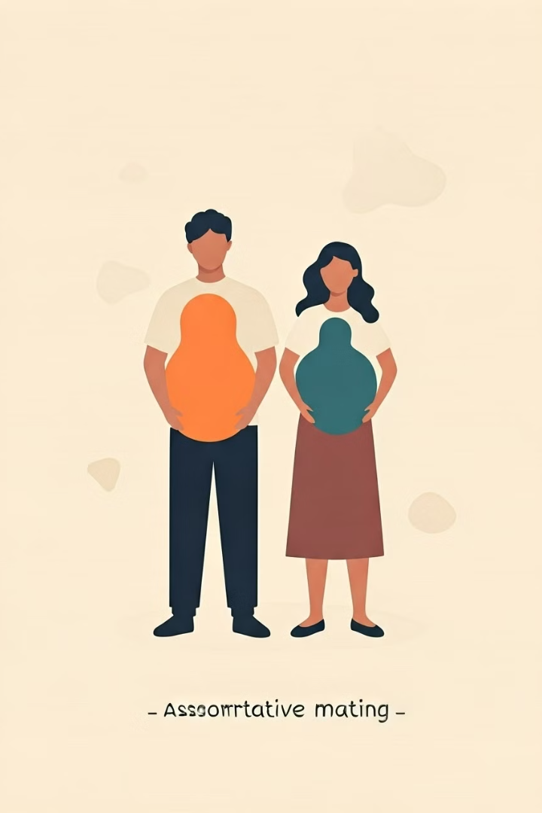
Assortative Mating Hypothesis
Pairing
Individuals pair based on status-increasing traits
Offspring
Higher in both parental traits
Limitations
Predictive power limited in monogamous societies

Slide 7

Health and Attractiveness
Theory
Prediction
Good Genes
Health linked to attractiveness
Bad Genes
Link only at lower end

Slide 8




Key Traits for Analysis
Intelligence
Health
Dominance
Sociability
Ongoing debates in literature
Inconsistent findings across studies
Central to person perception
Key in social interactions

Slide 9

Unresolved Issues
1
Discrepancies
Between perceived and measured associations with attractiveness
2
New Theories
Support across empirical findings uncertain
3
Reliability
Of trait judgments based on attractiveness influence

Slide 10

Study Objectives
Comprehensive Meta-Analysis
On perceived and measured associations
Incorporate Recent Findings
Update 30-year-old meta-analyses
Address Unresolved Issues
From previous literature reviews

